Slide 1





Transfer Learning Based Automated Debugging Across Multiple Programming Languages
Group 18
Aabha Pingle Dattateja Reddy Anakala Parth Sanjay Shelar Prerana Shenoy S P Sharan Murli

Slide 2
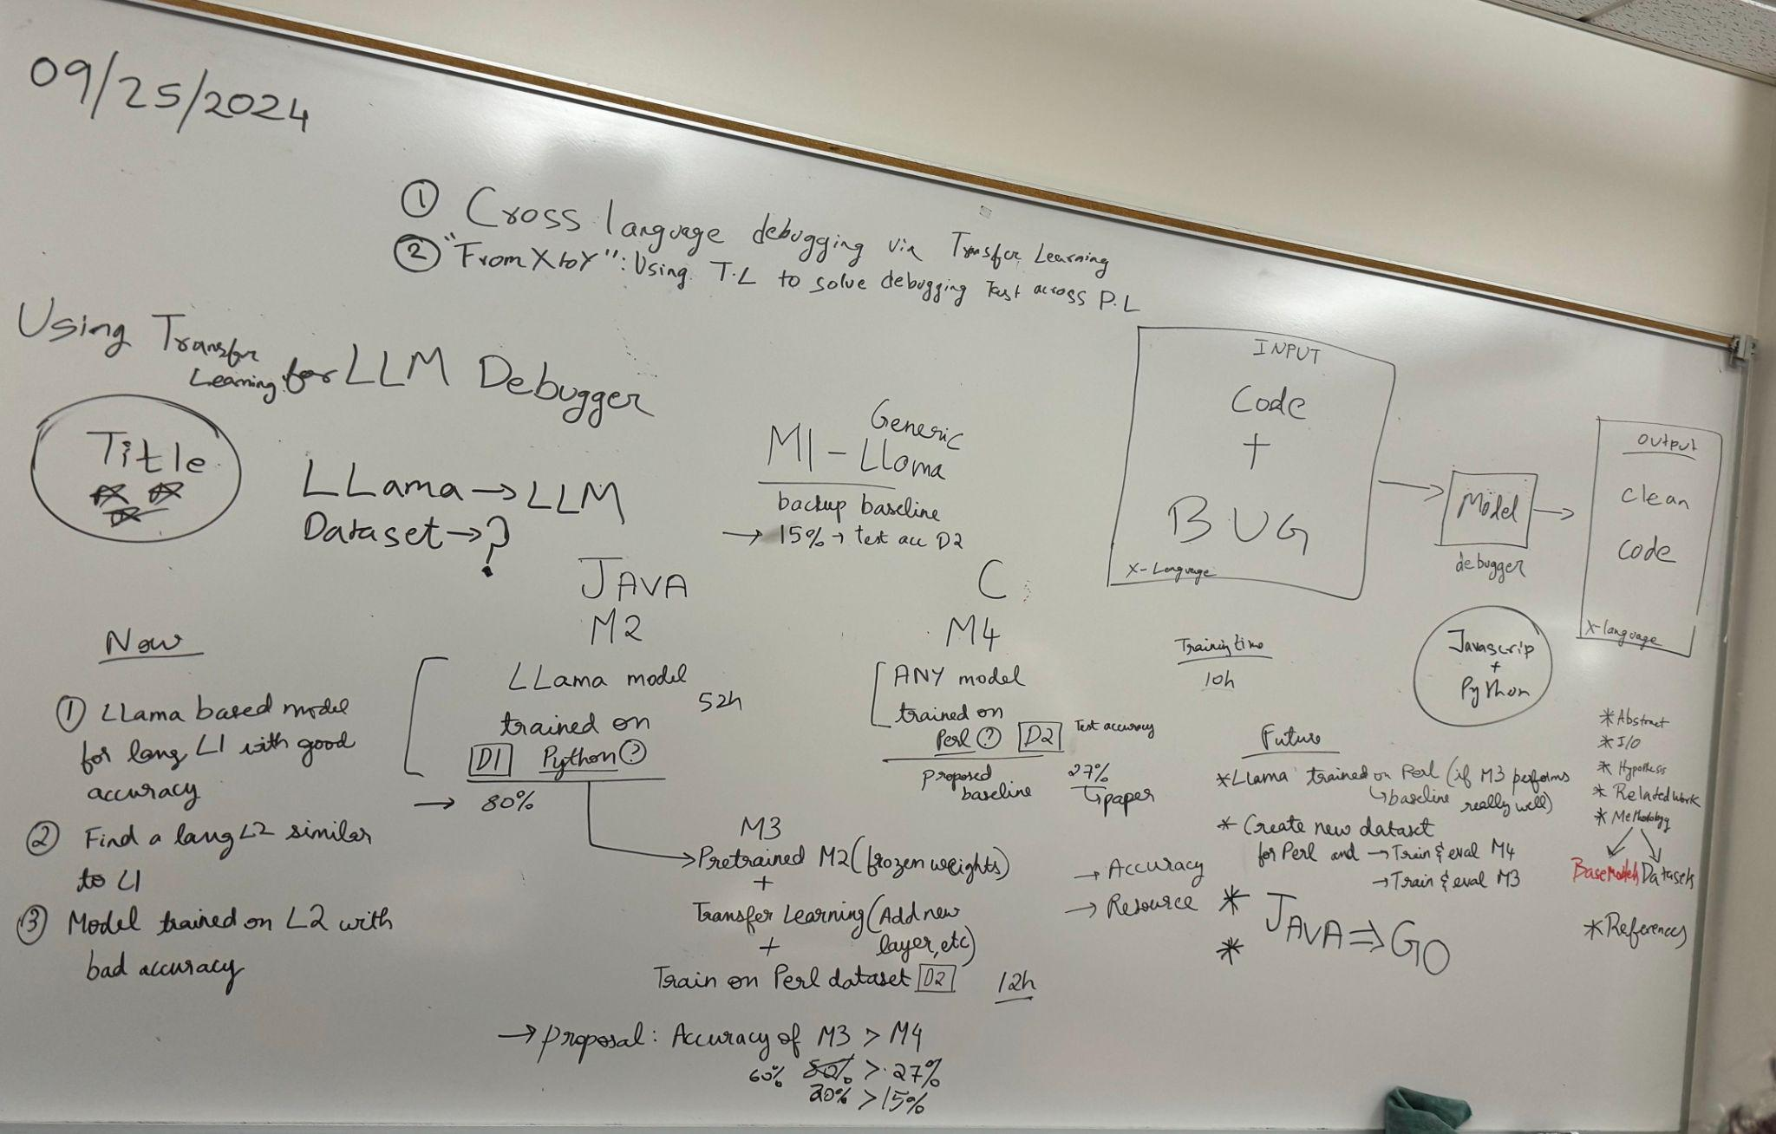
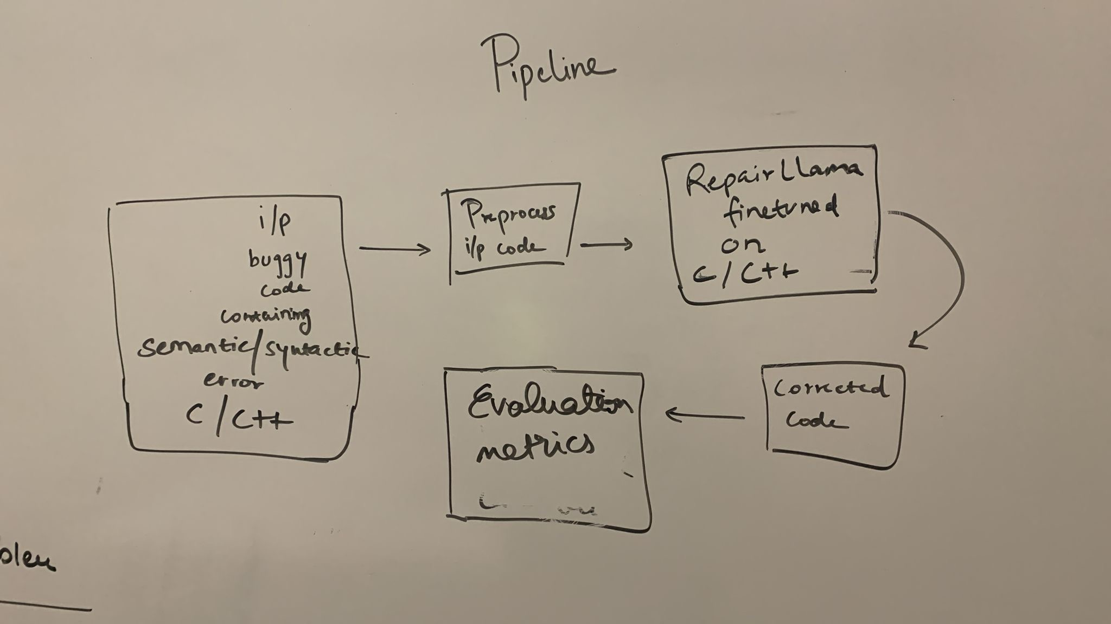
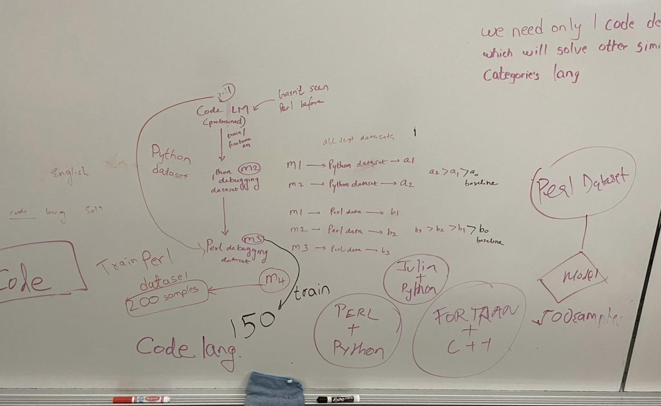
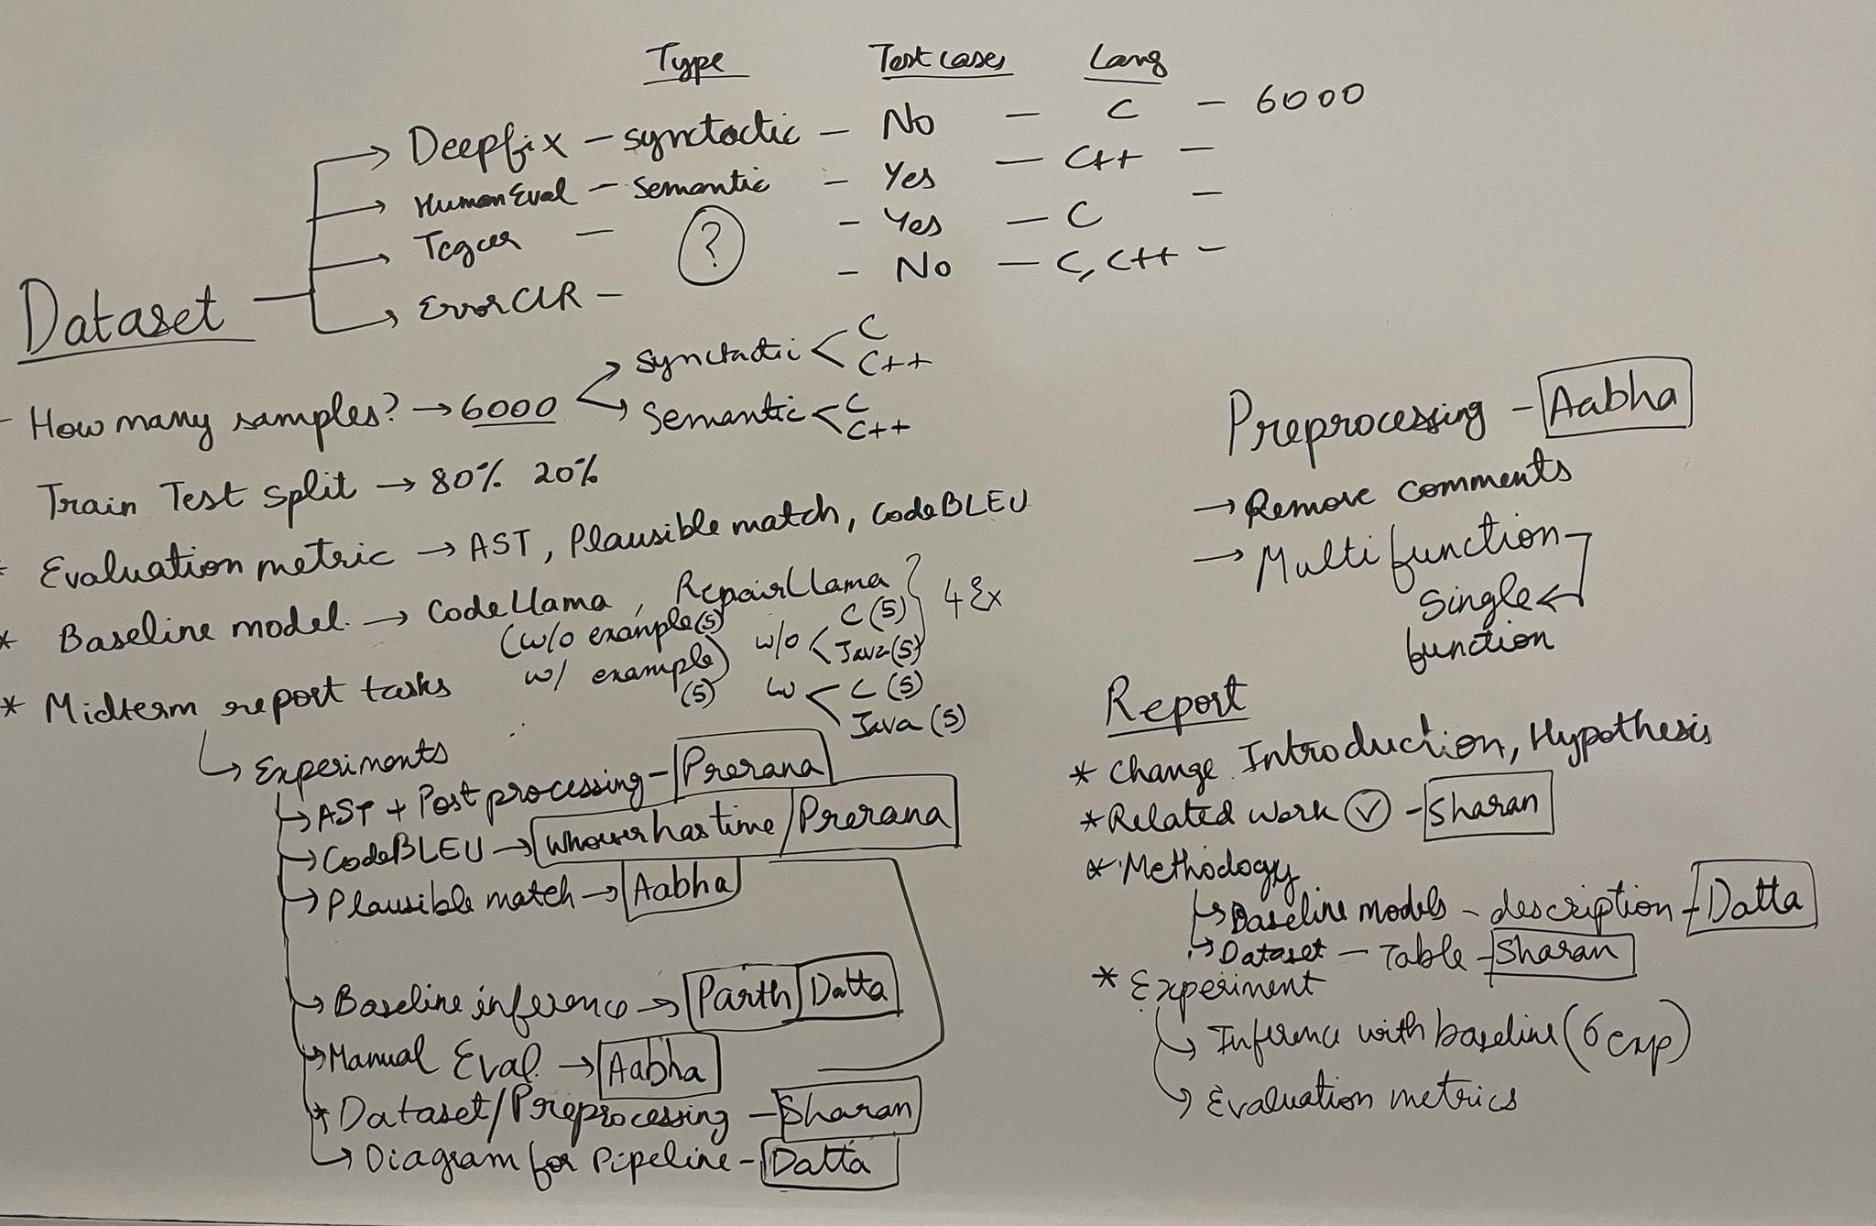
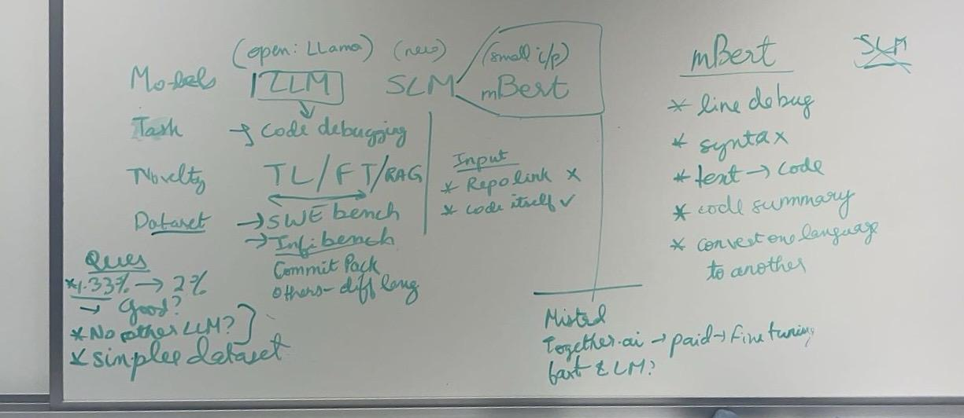
Motivation
Large Language Models (LLMs) have shown significant improvement in learning and understanding code and have the potential to debug or correct buggy code.
Recent advancements in code debugging have been achieved in languages like Java and Python.
These models do not perform well on debugging C/C++ through prompting alone and will need more powerful techniques to understand the intricacies of C/C++.
Notes:
Datta

Slide 3
Prompting on Baseline models - CodeLlama and RepairLlama`
CodeLLaMA, based on Meta’s LLaMA 2 architecture, is trained on a massive dataset of code comprising different programming languages - performs a range of code-related tasks effectively, including generating syntactically correct code and understanding complex code structures.
RepairLLaMA, an extension of CodeLLaMA fine-tuned on the MegaDiff dataset, is optimized for automated program repair in Java to enhance its debugging performance across multiple lines of code.
To further assess the necessity of fine-tuning RepairLlama, we employed zero-shot and one-shot prompting techniques.
Experiments | CodeBLEU | Plausible Match | AST
RepairLlama inferred on Java Code | 0.94 | 0.8 | 0.95
RepairLlama inferred on C Code | 0.81 | 0.2 | 0.86
RepairLlama inferred on C++ Code | 0.85 | 0.5 | 0.81
CodeLlama inferred on C Code | 0.63 | 0 | 0.71
Table 1: Prompting with Baselines (CodeLlama and RepairLlama)
Notes:
Datta - IMPORTANT

Slide 4
Prompting on RepairLlama - Error Analysis
Inference Number | Error Type | Java | C++ | C
1 | Operator Misuse | ☑️ | ☑️ | ☑️
2 | Missing Logic | ☑️ | ❌ | ❌
3 | Excess Logic | ☑️ | ❌ | ❌
4 | Variable Misuse | ☑️ | ❌ | ❌
5 | Multi-Function Error | ❌ | ❌ | ❌
Table 2: Error Analysis and how RepairLlama performs on these errors
Notes:
Sharan

Slide 5
Research Question
While many models excel at code generation, recent developments have specifically enhanced performance in automatic program repair tasks.
RepairLlama is the state-of-the-art in code debugging in Java and has shown remarkable results for automated program repair.
We hypothesize that RepairLlama can be fine-tuned for debugging tasks in C/C++, demonstrating cross-linguistic transferability in error detection and correction.
Would transfer learning on RepairLlama improve the performance of automated program repair in C/C++?
What are the best metrics to evaluate program repair tasks?
Notes:
Sharan - IMPORTANT

Slide 6
Datasets
To finetune the model, we plan on using multiple datasets consisting of C and C++ programs.
We also plan to fine-tune the model with syntactic and semantic datasets to enhance its ability to debug a wide range of errors.
Dataset | Lang | # Examples | # lines of code | Test Cases | Single/multi function | Error Type
Deepfix | C | 6975 | 12.35 | No | Single:1336 Multi:5639 | Syntactic
Tegcer | C | 21995 | 28.91 | No | Single:13738 Multi:8257 | Semantic/Syntactic
ErrorCLR | C/Cpp | 8511 | 15.43 | Yes | Single:8498 Multi:13 | Semantic
HumanEvalPack | Cpp | 164 | 10.61 | Yes | Single:138 Multi:26 | Semantic
Table 3: C/C++ debugging dataset analysis
Notes:
Sharan

Slide 7
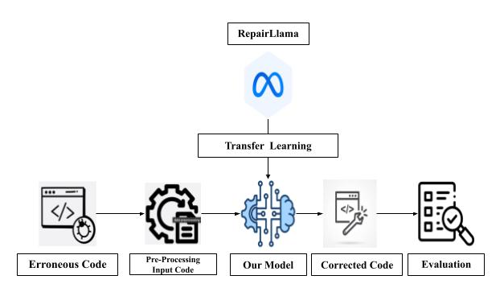
Proposed Method
Figure 1: End-to-End Pipeline
Notes:
Prerana

Slide 8
Proposed Method
Preprocessing:
We retained only programs containing a single function to focus on isolated logical errors and syntax corrections.
We standardized the buggyCode and correctedCode by conducting thorough comparisons to ensure that only programs with meaningful differences between the buggy and corrected versions were included.
Fine Tuning:
LoRA (Low-Rank Adaptation) is used for parameter efficient finetuning that uses fewer learnable parameters through matrix approximation.
This helps fine-tuning to converge and clearly contributes to the effectiveness of the model in fixing bugs outside the fine-tuning data distribution
Evaluation Metrics:
CodeBLEU: weighted combination of n-gram match (BLEU), Abstract Syntax Tree match, weighted n-gram match (BLEU-weighted), and data-flow match scores
Abstract Syntax Tree (AST): using AST differencing of two codes for comparison
Plausible Match: ratio of the number of examples that passed all test cases to the total number of examples
Notes:
Prerana - IMPORTANT
LoRA is a type of PEFT that decomposes the weight matrix into two low rank matrices -> lesser parameters to train
Converges faster and generalizes well
Also helps in keeping the learnings of the base model by freezing its weights and only added additional weights in the attention layers
Repairllama is using exact match, AST match, semantic match - along with these we also evaluated on CodeBLEU

Slide 9
Current Results - Experiments using CARC
We make use of TEGCER dataset for model fine tuning of automated program repair in C.
Using `<unk>` as padding token ensures correct padding handling, stabilizing training and improving loss. Thus, we can see a significant improvement in the third experiment.
Experiment | Epoch | max_steps | learning rate | batch size | Optim | Train loss | Eval Loss
1 | 5 | 2000 | 5e-4 | 4 | Adam | 0.4923 | 0.5383
2 | 10 | 4000 | 5e-4 | 4 | Adam | 0.3402 | 0.5349
3 | 5 | 4000 | 2e-5 | 4 | Adam | 0.2715 | 0.2744
Table 4: Finetuning Experiments
Notes:
Aabha - IMPORTANT TEGCER DATASET - Targeted Example Generation for Compilation Errors
Epoch - number of times the model sees all the examples
Max_steps - maximum number of batches to run
Learning rate - step size taken in the direction of the negative gradient to minimize the loss function.
Batch size - 4 samples are used to compute the gradient and update the model weights before the next batch of 4 samples is processed.
Optimiser - Adaptive Moment Estimation - minimize the loss function by manipulating the gradient to update weight
Loss Function - Cross-Entropy Loss

Slide 10
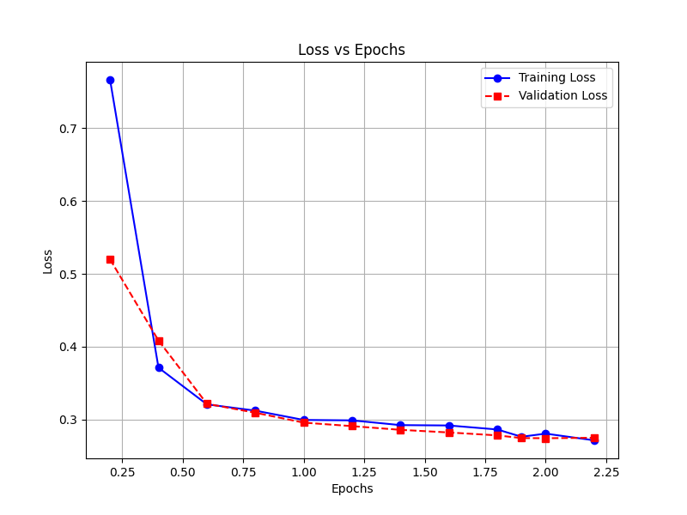
Current Results - Experiments using CARC
Figure 2: Training and Validation loss vs epochs
Notes:
Aabha Notes - Increase the number of epochs, the loss reduces, we thus find the optimal number of epochs

Slide 11
Current Results - Inferences
Input Buggy Code | Gold Correct Code | Inference on RepairLLama | Inference on RepairLLama Finetuned on C data
#include <stdio.h> #include <math.h> int main(){ int n; double sum=0; scanf("%d",&n); for(int i=1;i<=n;i++){ sum=sum*1.0+sqrt(i);} printf(".2lf",sum); return 0; } | #include <stdio.h> #include <math.h> int main(){ int n; double sum=0; scanf("%d",&n); for(int i=1;i<=n;i++){ sum=sum*1.0+sqrt(i);} printf("%.2lf",sum); return 0; } | </s> ----------------- #include <stdio.h> #include <math.h> int main(){ int n; double sum=0; scanf("%d",&n); for(int i=1;i<=n;i++){ sum=sum*1.0+sqrt(i);} printf("%lf",sum); return 0; } </s> | Patch 1: #include <stdio.h> #include <math.h> int main( { int n; double sum=0; scanf("%d",&n); for(int i=1;i<=n;i++){ sum=sum*1.0+sqrt(i);} printf("%.2lf",sum); return 0; }
#include <stdio.h> #include <stdlib.h> int main(){ int i,n,k; scanf("%d",&n); char *str=(char*)malloc(n*sizeof(char));//dynamic memory allocation for(i=0;i<n;i++){ scanf("%c",*str[i]); } return 0; } | #include <stdio.h> #include <stdlib.h> int main(){ int i,n,k; scanf("%d",&n); char *str=(char*)malloc(n*sizeof(char));//dynamic memory allocation for(i=0;i<n;i++){ scanf("%c",&str[i]); } return 0; } | </s> ----------------- #include <stdio.h> #include <stdlib.h> int main(){ int i,n,k; scanf("%d",&n); char *str=(char*)malloc(n*sizeof(char));//dynamic memory allocation for(i=0;i<n;i++){ scanf("%c",str[i]); } return 0; } </s> | Patch 4: #include <stdio.h> #include <stdlib.h> int main(){ int i,n,k; scanf("%d",&n); char *str=(char*)malloc(n*sizeof(char));//dynamic memory allocation for(i=0;i<n;i++){ scanf("%c",&str[i]); } return 0; }
Table 5: Finetuned Model Inference examples
Notes:
Aabha -
P1 - sum of square roots of integers, formatted output to print a floating-point number with two decimal places. MISSING FORMAT SPECIFIER, LF IS DOUBLE TYPE, 0.2
P2 - This code aims to dynamically allocate memory for a string of length nn, then attempts to read nn characters into that string using scanf. str is a pointer to this dynamically allocated memory. Should pass the address of the str[i]
Repaillama wasn’t able to resolve these errors but repaircllama, our model is correctly able to resolve the errors
repai

Slide 12
Evaluation Scores
Models | CodeBLEU | Plausible Match | AST
CodeLlama | 0.63 | 0 | 0.71
RepairLlama | 0.81 | 0.2 | 0.86
RepairCLlama (ours) | 0.91 | 0.4 | 0.89
Table 6: Evaluation Metrics of ours against baseline models for C code
Notes:
Aabha - IMPORTANT
Code blue - considers both syntax and semantics between the generated and gold correct code precision of matching n-grams
AST - AST represents the syntactic structure of a programing language in tree like format
Plausible - test cases

Slide 13
Challenges | Learnings
When a buggy code example contains multiple errors, the model tends to address only one bug, leaving the others uncorrected. | Learned how to use LoRA for finetuning and the capabilities of finetuning
Similar to RepairLlama, we wanted to first target single function error debugging. This involved data preprocessing of all our datasets to single function errors which took a lot of effort. | We attempted to fine-tune the model by providing code and prompt inputs. This fine-tuned model performed better than the one without prompts. Through this process, we learned how to effectively prompt and fine-tune a model using prompts.
Zero-shot prompting and simple one-shot prompting performed poorly on the task, often returning the input unchanged. This underscores the need for fine-tuning the model on a C/C++ debugging dataset. | Experimented with different evaluation metrics and datasets - learned how to analyze and choose the best ones for our task
Table 7: Challenges and Learnings
Notes:
Parth

Slide 14
Next Steps
Completed so far
Top priority before final report
Other experiments if time permits
Midterm Report
Finetune on Tegcer dataset and evaluate
Finetune on other datasets
Target improving semantic debugging
C/C++ debugging Model as a baseline
Resolve multiple bugs using iterative inferencing
Data preprocessing, finetuning using LoRA, finetuning with prompts along with code, prompt engineering
Check if the model learns better with other datasets
Finetune to improve the plausible match evaluation metric
Prompting and evaluating on it with a new C/C++ debugging baseline model
When there are multiple bugs, only some bugs get resolved. Can we iteratively give the output to the model to resolve bugs?
Notes:
Parth - IMPORTANT

Slide 15
Thank you
Appreciate all the guidance given by our TA Brihi Joshi!
Questions?

